Slide 1
Data Visualization & Communication
Week 2 Practise Exercises

Slide 2
Exercise 1
Before starting to address analysis questions, it’s a good idea to get a feel for what our data look like. To get started, I suggest you use the Row and Column shelves and the Marks Card in the Tableau workspace to determine:
1) How many unique dogs are in the data set (indicated by the number of unique entries in Dog ID)?
2) How many unique (human) users are in the data set (indicated by the number of unique entries in User ID)?
As a discussion point, what does it mean if the number of unique User IDs is different from the number of unique Dog IDs?
Another thing it is helpful to do before addressing our primary analysis questions is to examine whether there are any questionable values in your key fields that may be mistakes or outliers. I suggest that you closely examine all of your variables, but I will highlight a few in particular here.
First, place Country in the Rows shelf as a dimension to see what countries are represented in our data set. If you turn that Country pill into a measure, you can aggregate it by Count (Distinct) to see how many countries there are in total.
Next, do the same for State. When you do, you will find that many entries in State have curious values! This is an example of how real-world data sets can be messy. To get an idea of what some of the strange values might mean, place State on the Rows shelf and State aggregated by Count on Text of the Marks card. You should get a table with all the possible values of State in the first column and the number of rows of data that have these values in the second column. Right-click (or CTRL-click) on a row in the table and select “View Data” to see what the raw data underlying each row in your table look like. Any ideas of what the numerical entries in the State field were likely supposed to represent (at one point)?

Slide 3
Exercise 1
As another quality check, place Sign in Count on the Rows shelf. Then de-aggregate the data in the workspace through the “Analysis” menu. You will see that there are some clear outliers in this variable. If you right-click/CTRL-click on the individual data points to see the raw data underlying them, note what columns of data seem to be common to all the
rows displayed at this point. We will want to examine these outliers and possibly exclude them from future analyses.
Recall that one way to exclude outliers is to group together the individual Dog IDs that are associated with all the extreme points on the graph, so that they can be filtered out of your analyses. For that to be possible, you will need to put the Dog ID field on Details of the Marks card. Note the difference between the raw data underlying the points you click on now, compared to before you put Dog ID on Details. Group together all the data points that have Sign In Counts of above 175.
We have confirmed that these Dog IDs represent test accounts that Dognition used to troubleshoot their website. For the rest of the practice exercises using the dognition_data_aggregated_by_dogid data set, exclude these Dog IDs from your analyses by putting the grouped variable you just made on the Filter shelf and excluding all of the data points in the group with extreme values.

Slide 4
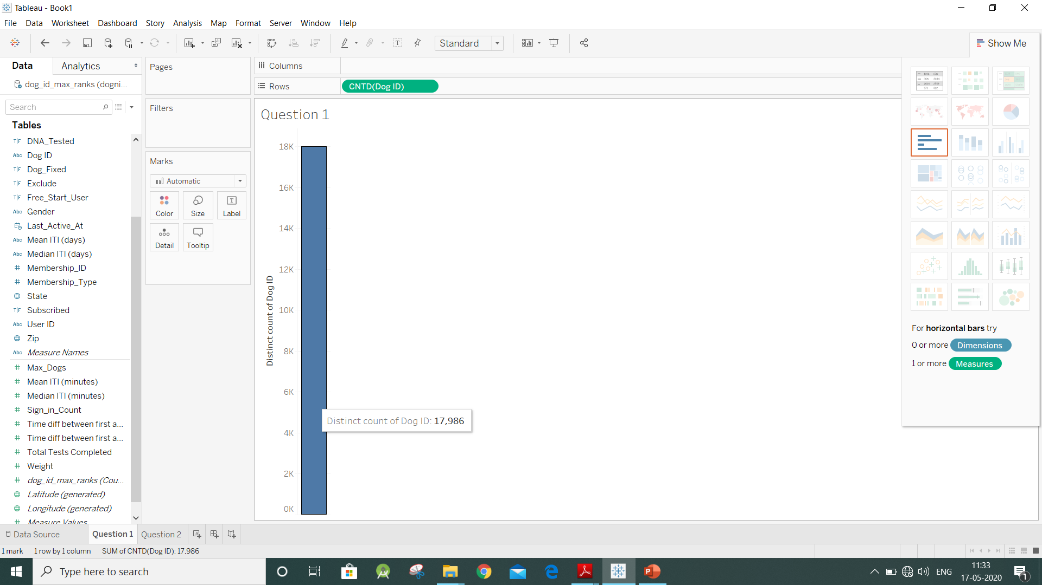
1. How many unique dogs are in the data set (indicated by the number of unique entries in Dog ID)?

Slide 5
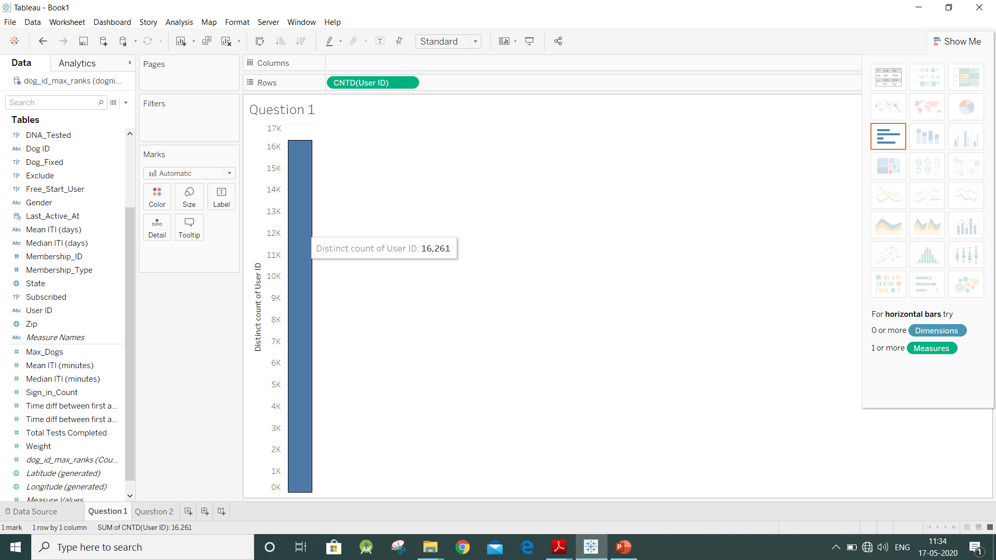
2. How many unique users are in the data set (indicated by the number of unique entries in User ID)?

Slide 6
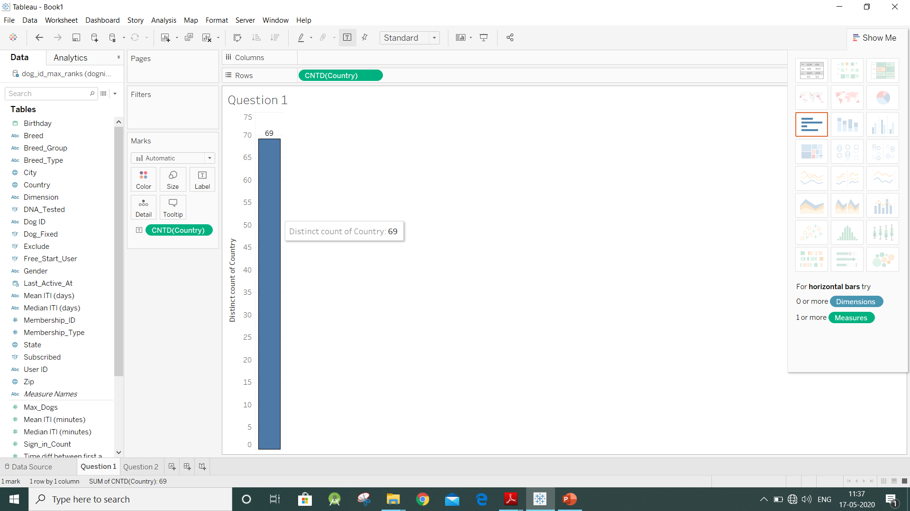
3. Aggregate countries by Count (Distinct) to see how many countries there are in total?

Slide 7
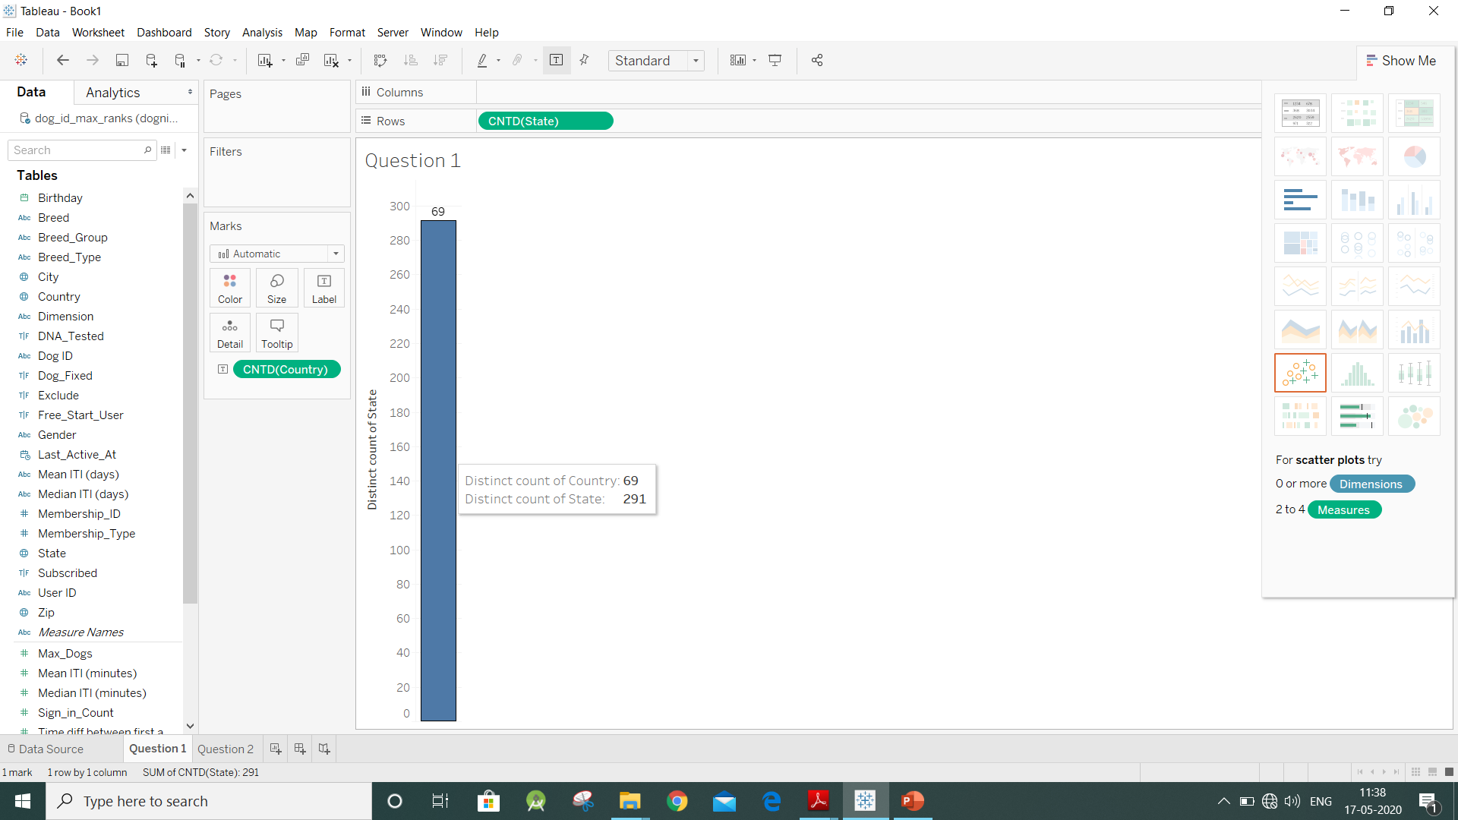
4. Aggregate states by Count (Distinct) to see how many states there are in total?

Slide 8
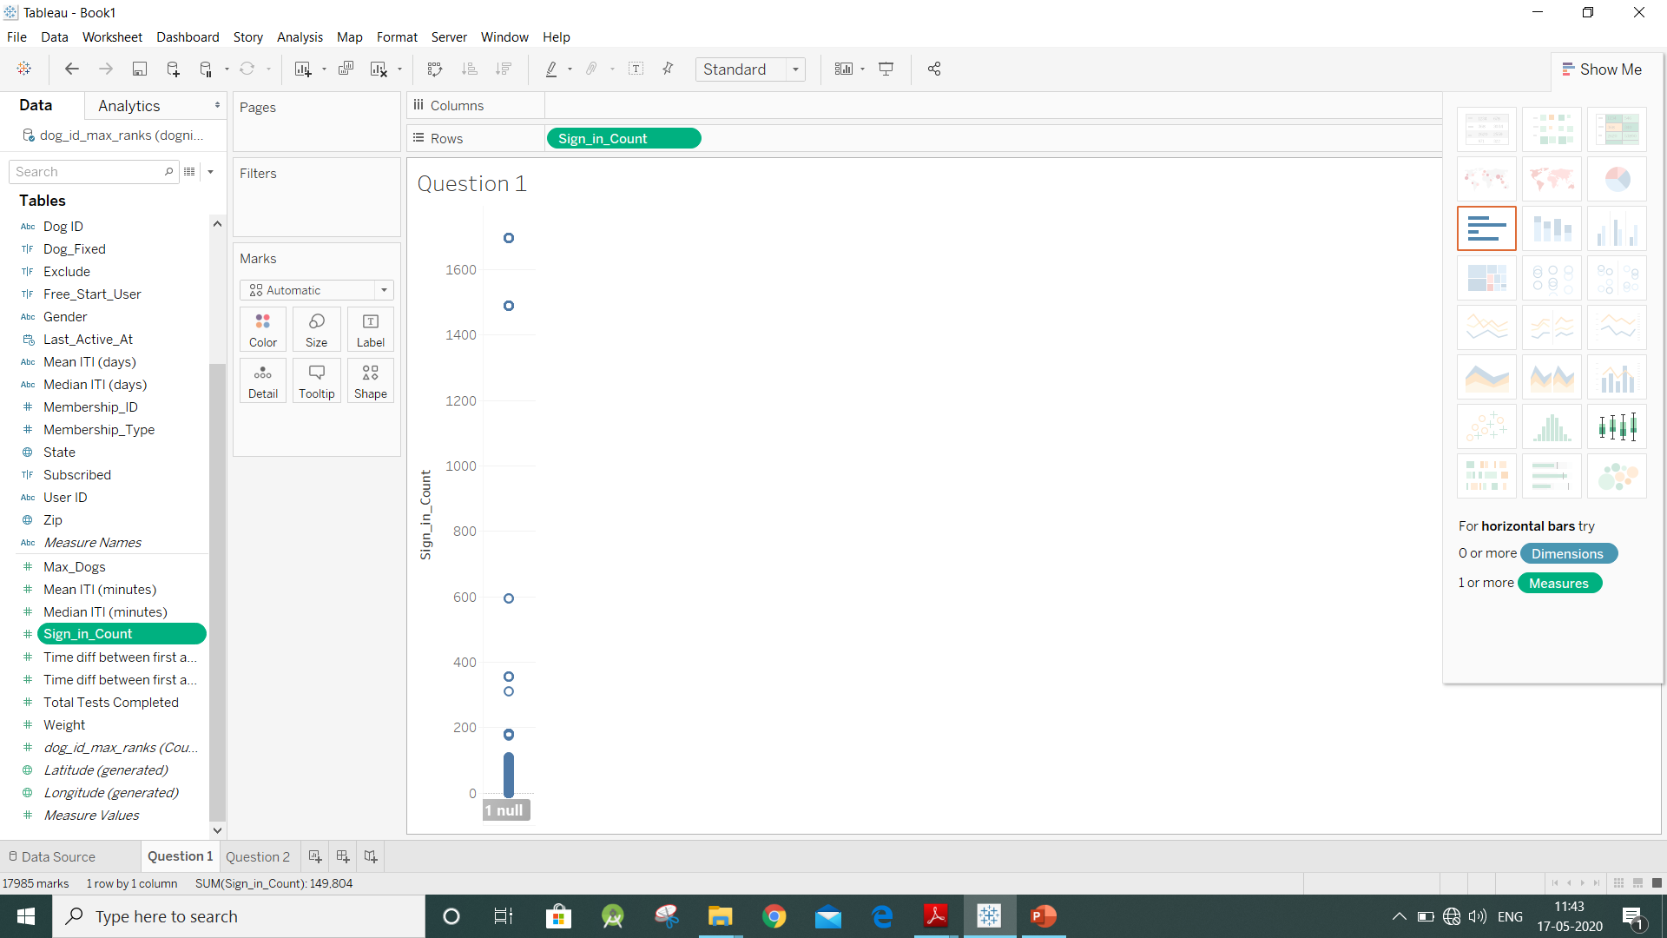
5.1 Examine some extreme outliers in sign_in_count (No. of times users sign in to dogition)

Slide 9
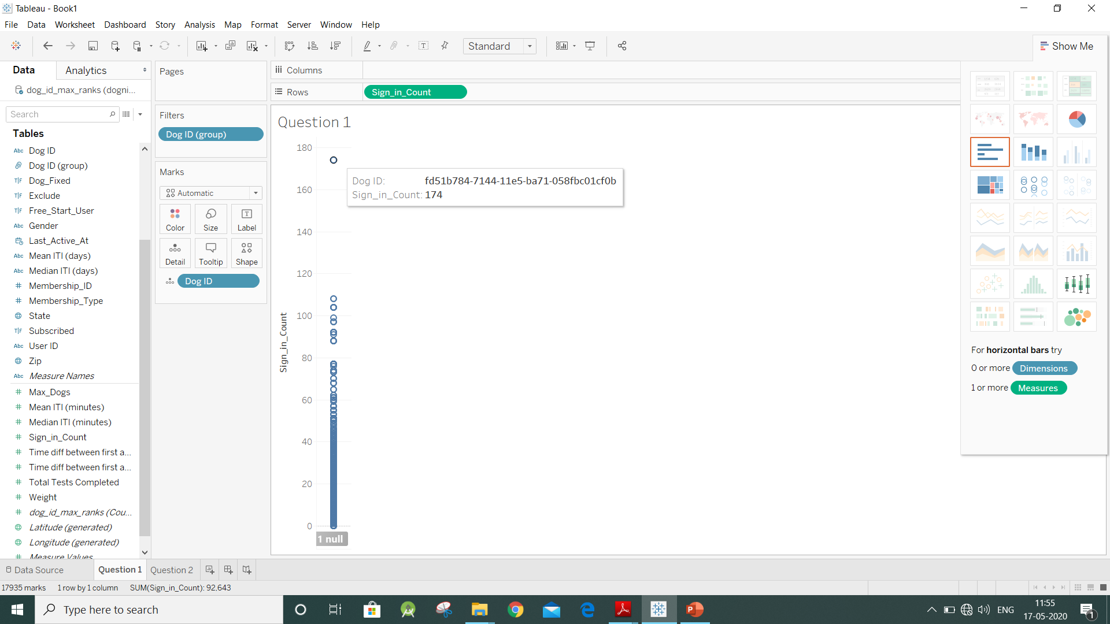
5.2 Grouping dog ID by examining the outliers caused in sign_in_count above 175

Slide 10
Exercise 2
Now that we have a feeling for what our data look like, we can start addressing some of the questions in our analysis plan. Our job is to make a recommendation to Dognition about what they could do to increase the number of tests customers complete. One way to start making hypotheses about the business changes that would be useful, is to identify the features of dogs or their owners that have correlated with increased completion scores in the past. The dognition_data_aggregated _by_dogid data set is well-suited for those types of questions, because it provides data about the total number of tests completed by each dog and/or human customer (as opposed to data about each test completed, which is a data set we will analyze next week).
In this exercise, we will focus on examining features of dogs that correlate with differences in the number of tests the dogs complete. The field representing the total number of tests customers completed is Total Tests Completed. We have also computed the mean and median “ITI,” or “inter-test interval,” in minutes and hours for the tests each dog completed, as well as the amount of time that elapsed between the first and last tests each dog completed. To address the question of how aspects of dogs’ personalities and breed types affect completion metrics, you can make visualizations with any of the variables described above, and the Breed Type, Breed Group, or Dimension variables. Try different combinations of dependent variables and independent variables in the Rows and Columns shelves and/or the Marks card. To aid in your interpretations, it may also be useful to know whether certain types of dog breeds tend to have certain types of personality types. As you complete these visualizations, recall that the Dimension field represents personality dimensions that can only be assigned to dogs after they have completed the Dognition Assessment, which is the first 20 tests. Overall, what trends do you see? Make notes for yourself on this.

Slide 11
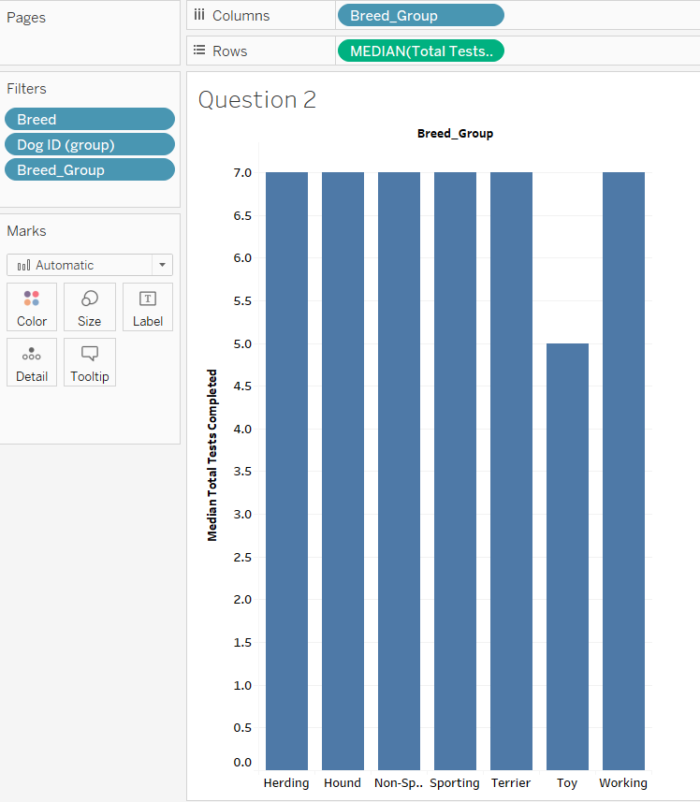
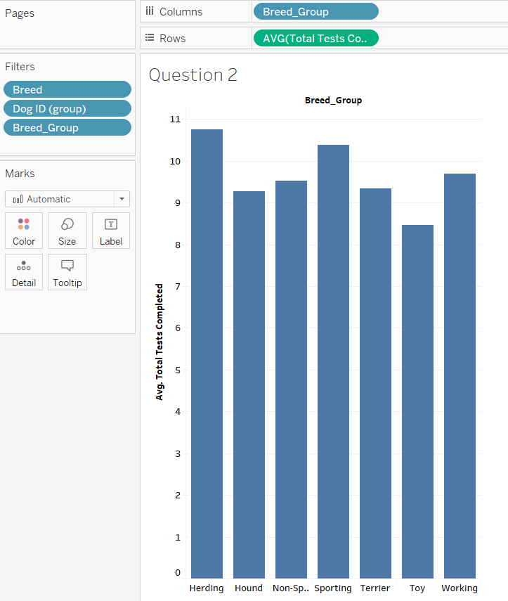
1. How many median/average total tests are conducted on dogs with specific breed-groups?

Slide 12
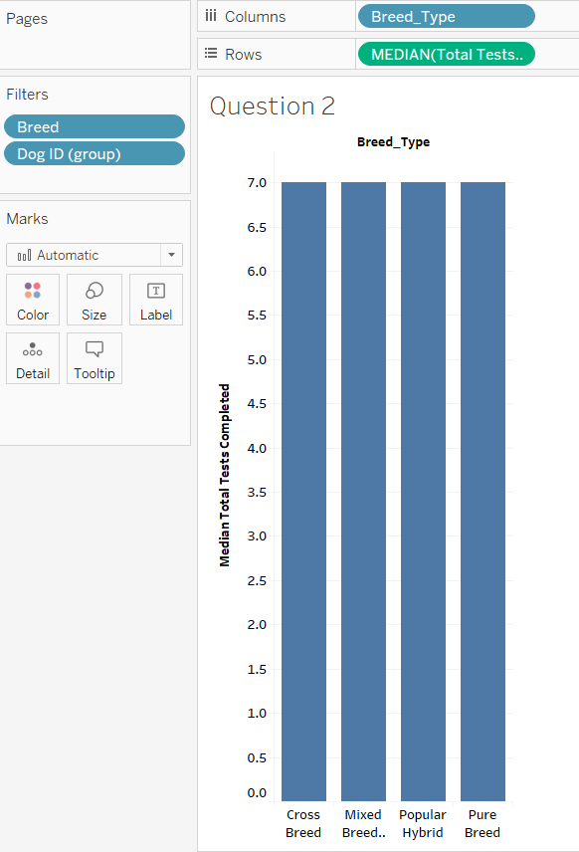
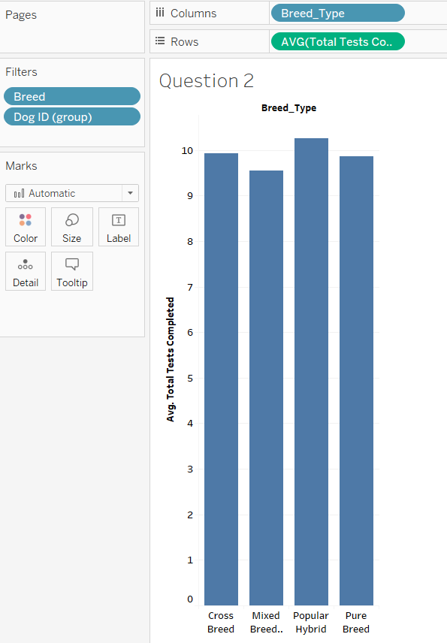
2. How many median/average total tests are conducted on dogs with specific breed-type?

Slide 13
Exercise 3
In this exercise, we will focus on examining variables that might give insight into owners’ personalities. We will start with the DNA tested and Dog Fixed variables. Owners who get their dogs DNA-tested are likely to be doing so (a) to confirm whether or not the dog is pure-bred, or (b) because they are really interested in finding out more about where their dog came from (http://www.caninejournal.com/dna-testing-for-dogs/). If either of these motivations are true, you might infer that such owners are inherently interested in learning more about their dog, and therefore hypothesize that these owners will be more likely to complete Dognition tests than other customer groups, due to the new insight the tests will provide about their dogs.
In addition, you might hypothesize that these effects would interact with what kind of breed type (pure-bred, mixed or unknown origin, etc.) the dog is, and whether or not the owner intended to breed the dog (which would be impossible if the dog were fixed, or spayed/neutered). Owners who intend to breed their dogs might be more interested in the personality of their dogs than others (because they will be interested in whether they are breeding a certain kind of temperament).
If you disagree with these hypotheses, write down your own hypotheses! Then test them by making visualizations with Total Tests Completed, Breed Type, Dog Fixed, DNA Tested, and Total Tests Completed. Remember to make sure each variable is correctly classified as a measure or dimension, as appropriate.

Slide 14
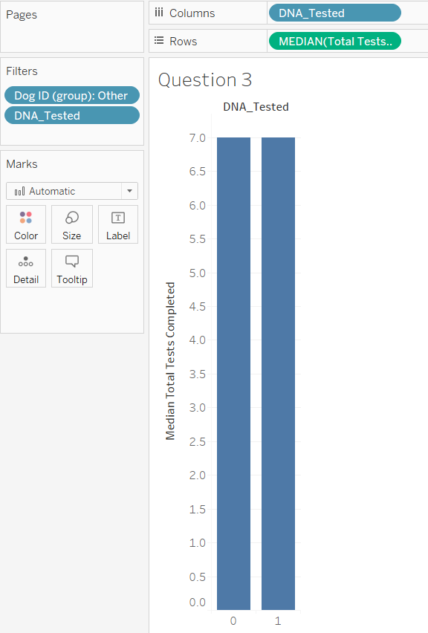
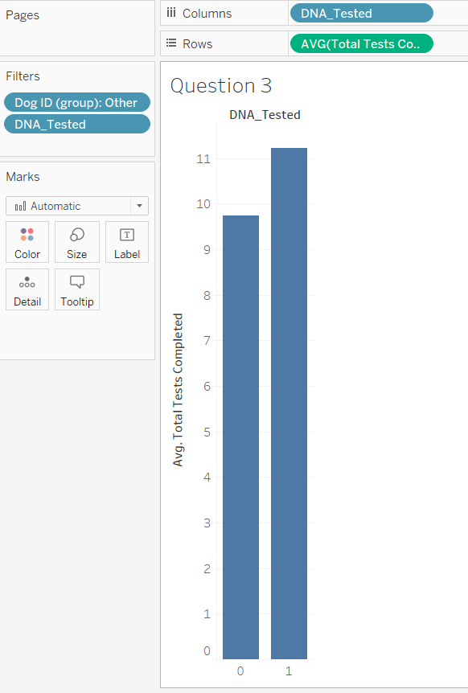
1. How many owners who have done DNA test of their dogs have completed how many average/median dognition tests?

Slide 15
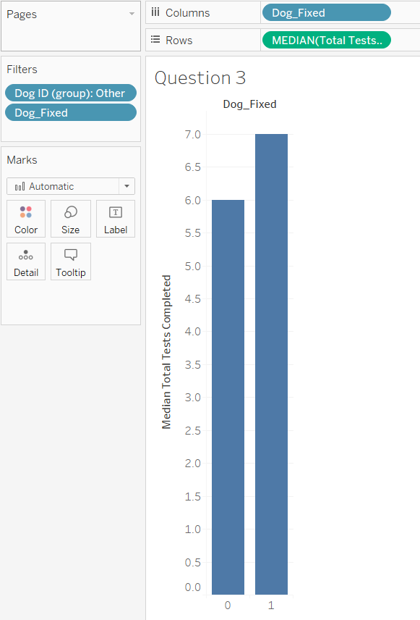
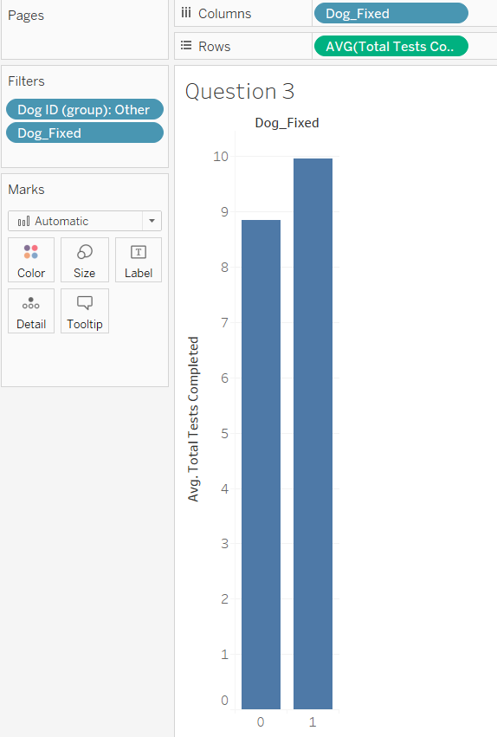
2. How many owners of fixed dog have completed how many average/median dognition tests?

Slide 16
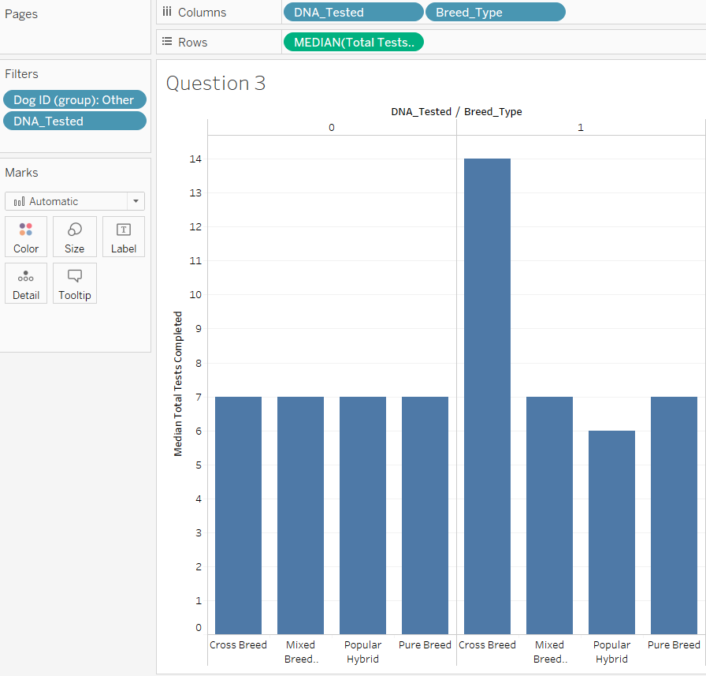
3. How many owners who have DNA-tested their dogs (yes or no) of specific breeds have completed how many dognition tests?

Slide 17
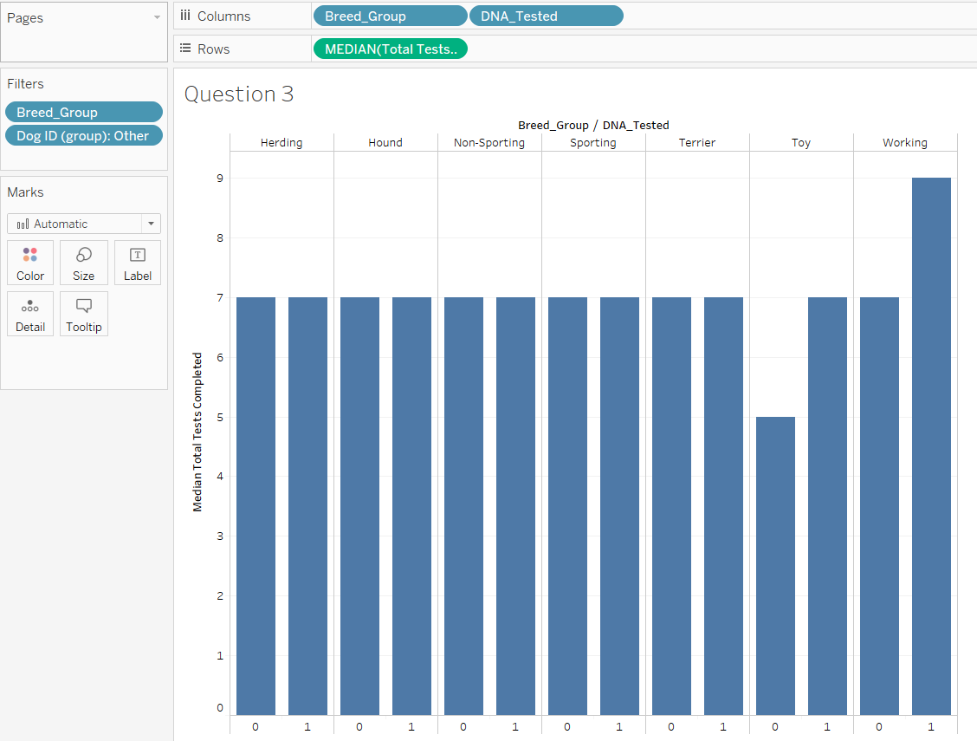
4. How many DNA-tested dogs of belonging to respective breed-groups have completed how many median dognition tests?

Slide 18
Exercise 4
In this exercise we are going to address the question of whether particular countries and/or states within the US have more Dognition customers than others. We will also address whether customers within specific geographic regions are more likely to complete more tests.
First, let’s find out what countries Dognition users tend to come from. To do this, we will ask how many distinct dogs have been tested in each country. Start by putting Dog ID aggregated by Count (Distinct) on the Rows shelf, and Country on the Columns shelf. Tableau will likely give you a bar graph (unless you started by using another type of graph). There are a lot of countries and it’s hard to get a good idea of the results when there is so much to scroll through, so let’s use a Tableau’s map instead. Click on the filled map icon in the Show Me card. Now each country should be colored by how many dogs have been tested there. This graph will illustrate clearly that most customers are located in the United States. To dig into this further, use the Filter shelf to limit what you are visualizing to only US records. Are there any states that clearly have more customers than others?
Next let’s examine whether there are any states that have customers that are more or less likely to complete their tests. Repeat the graphs above using Total Tests Completed as your dependent variable. What patterns do you see? As you interpret those patterns, make sure to also check how many records are being aggregated in each state. One thing that becomes immediately apparent as you make these graphs is that the median and average numbers of tests completed seem to be higher than what we’ve seen in a lot of previous graphs. Is it possible that US customers tend to finish more tests than non-US customers?

Slide 19
Exercise 4
Use Country to make 2 groups: the first group should consist of the US, and the second group should consist of all other countries. Now try some visualizations with Total Tests Completed and your new Country (grouped) variable. How would you make a visualization that would let you test if there are any countries who tend to complete more tests than US customers AND who have enough records in them that you would feel comfortable interpreting their results?
As a point of discussion, how can you use the information from these geographic analyses to make a recommendation about a geographical market Dognition should either nurture or move more into?

Slide 20
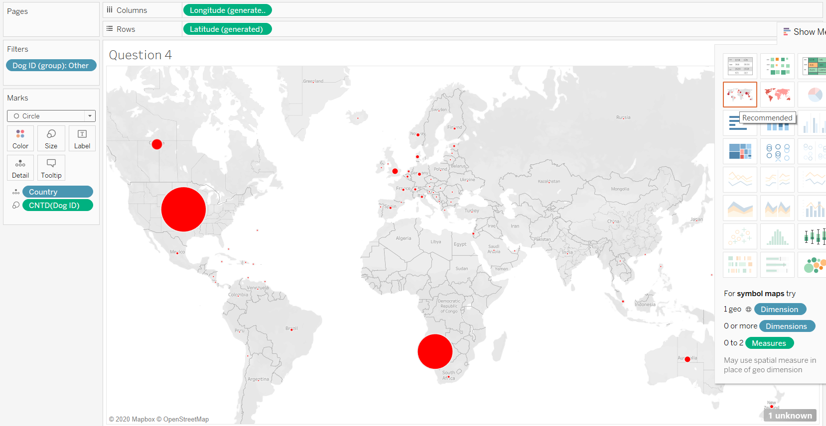
1. How many distinct dogs have been tested in each country? (Red circles represent dog users in countries)

Slide 21
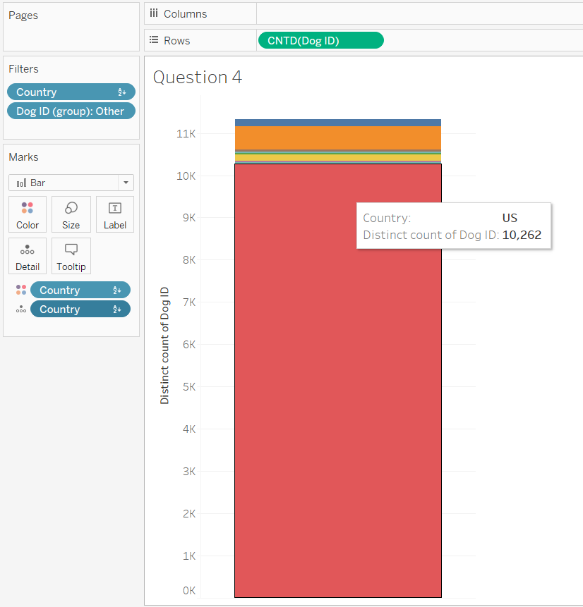
2. How many distinct dogs have been tested in each country? (9 countries - AU, CA, DK, FR, NZ, US, etc; were selected for better understanding of distribution of dog users across the countries)

Slide 22
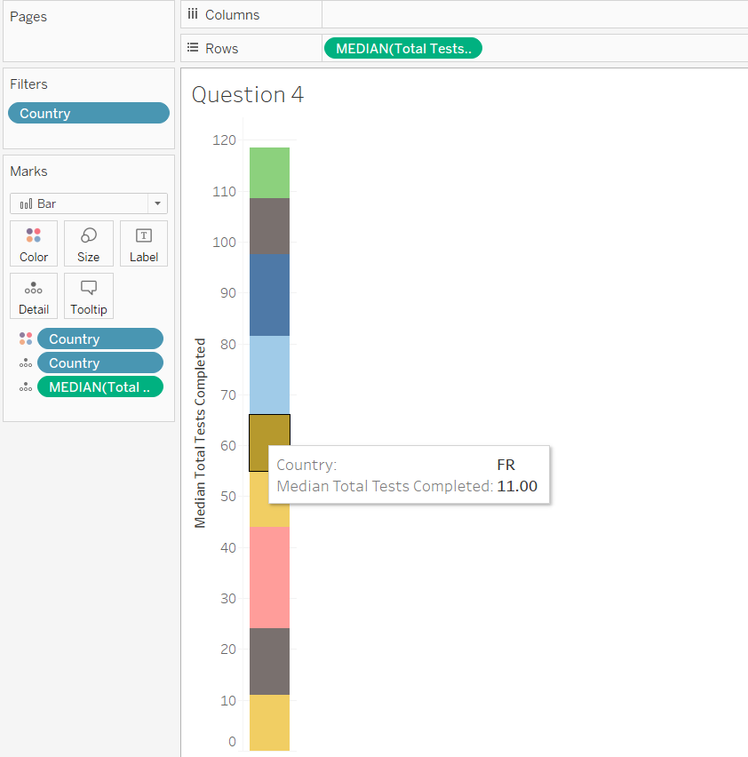
3. What are the median tests completed by users in each country?
(9 countries selected for clear visualization and hence better result analyzing)

Slide 23
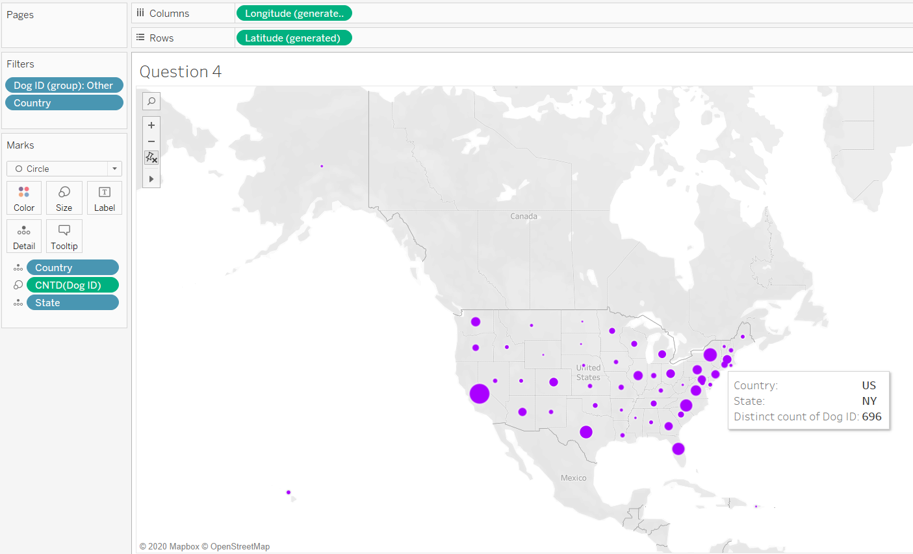
4. How many distinct dogs have been tested in different states of US?

Slide 24
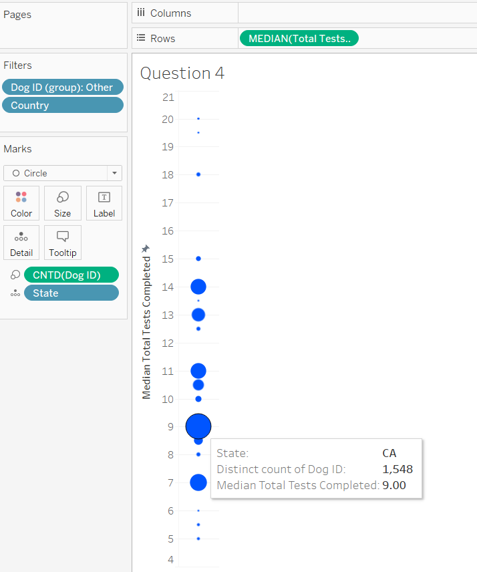
5. Analyzing distinct no. of dogs users and median tests completed by users in different states of US?
(Change the shape from BAR to CIRCLE as highlighted in Marks card)

Slide 25
Exercise 5
In this exercise, we are going to try to assess the hypothesis that customers who complete tests quickly are more likely to complete more tests overall. As often happens in real-life scenarios, the data we have in this version of the data set are not perfectly suited to answer this question. Nonetheless, we can still gain some useful insight.
The two variables we have available related to test completion rate are Median ITI and Mean ITI. It might be helpful to review how these fields were computed. I took all the time-stamps (i.e., the recorded day/time of completion) from the test records of a given Dog ID in a separate data set (which we will use next week), and computed the amount of time between the time-stamp of each test. That gave me a collection of inter-test intervals for each dog. If a dog completed 4 tests, I recorded the mean and median of 3 inter-test intervals.
If a dog completed 20 tests, I recorded the mean and median of 19 inter-test intervals. An important fact to remember here is that customers could complete the first 20 tests of the Dognition Assessment as quickly as they wanted, but then they would only be able to complete one test per month after that. Therefore, our question about completion rate really only makes sense if we look at the first 20 tests.
However, since the dognition_data_aggregated_by_dogid data set has the data aggregated at the level of Dog ID, not at the level of individual tests, we can’t just filter out all the data associated with tests 20-45. Instead we have to filter out all the data from dogs who completed 20 or more tests.

Slide 26
Exercise 5
Sadly this means (a) we will throw out some data in this analysis that could have otherwise been useful, and (b) our analyses will be biased towards dogs who do not complete all the Dognition Assessment tests, which might not translate well to dogs who do finish the Dognition Assessment tests. Such is life, in the data world.
With all of that in mind, we can try to address our question about completion rate by running a set of regressions treating Total Tests Completed as a measure. Start by filtering out all of the data from dogs who completed 20 or more tests. Then put Total Tests Completed on the Columns shelf. Then put Median ITI and Mean ITI on the Rows shelf, and un-aggregate the data. After that’s completed, add a trend line to each graph. You might be surprised to observe that the trend lines appear to go in opposite directions. How can that be? I suggest you watch the video we supplied in the course materials about the
effects of outliers again. You may also find it helpful to look over these resources about how outliers can affect regression lines :
http://stattrek.com/regression/influential-points.aspx?Tutorial=AP
http://discuss.analyticsvidhya.com/t/effects-of-outliers-on-regression-model/2403/2
What do you think the best interpretation of these results are? Would these results influence any recommendations you make to Dognition? Use the Course Discussion Forums to ask any questions or share your thoughts.

Slide 27
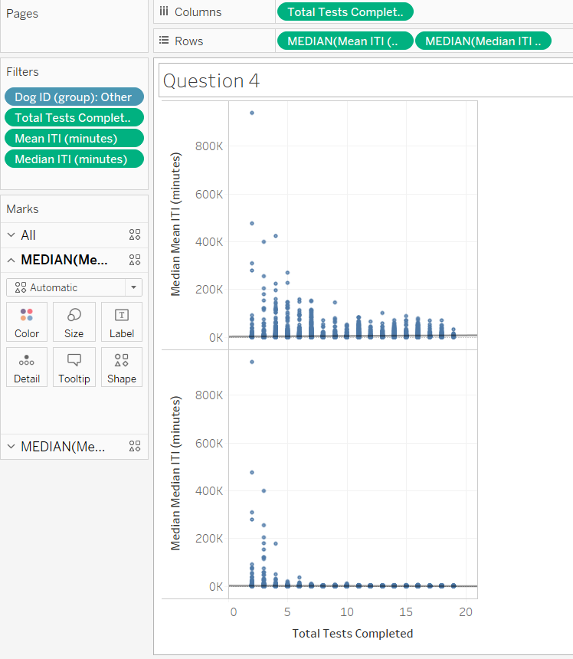
1. Trend Lines of Mean ITI (mins) and Median ITI (mins)

